Slide 1
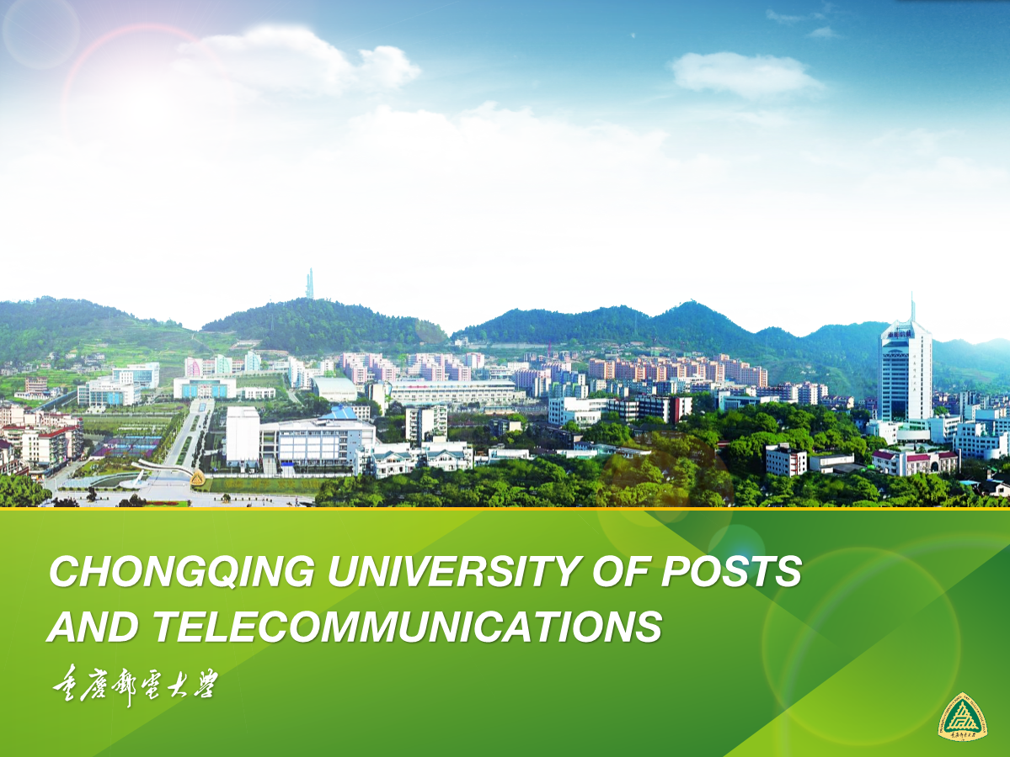
CHONGQING UNIVERSITY OF POSTS
AND TELECOMMUNICATIONS

Slide 2
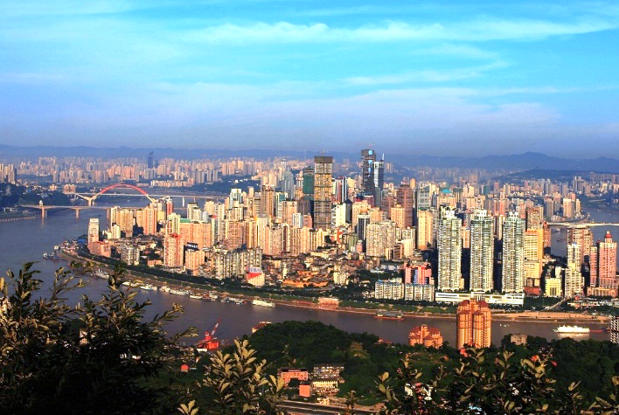
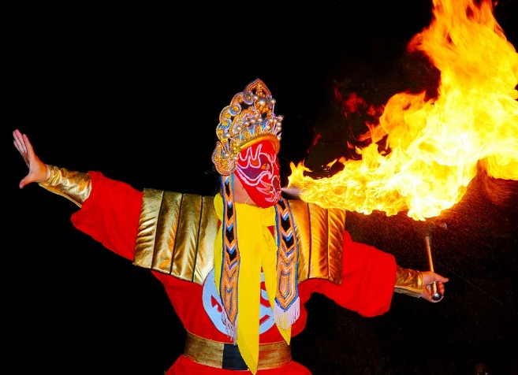
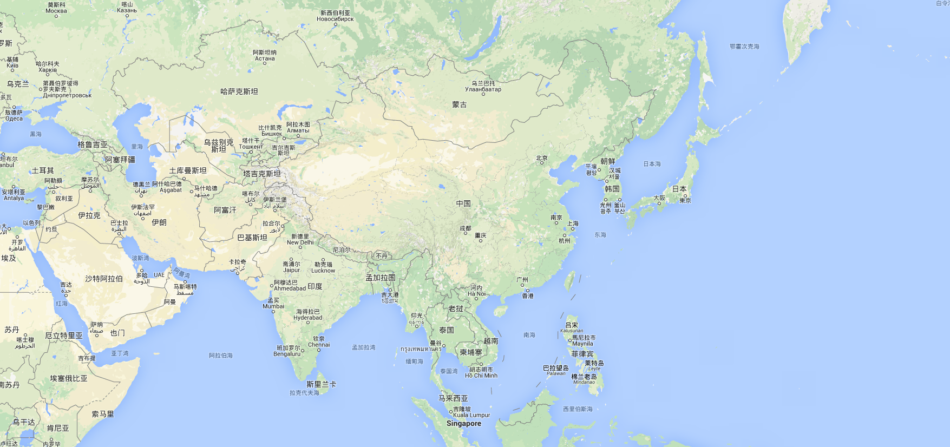
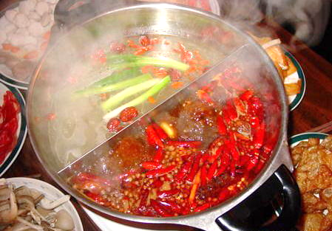
ABOUT
CHONGQING
CHONGQING
Over 3000 years in history and local culture;
The largest inland city of rivers and mountains on the planet with a population over 32 million;
The only municipality city in Southwest China, the economic center of the upper Yangtze.ggg
Over 3000 years in history and local culture;
The largest inland city of rivers and mountains on the planet with a population over 32 million;
The only municipality city in Southwest China, the economic center of the upper Yangtze. reiver

Slide 3
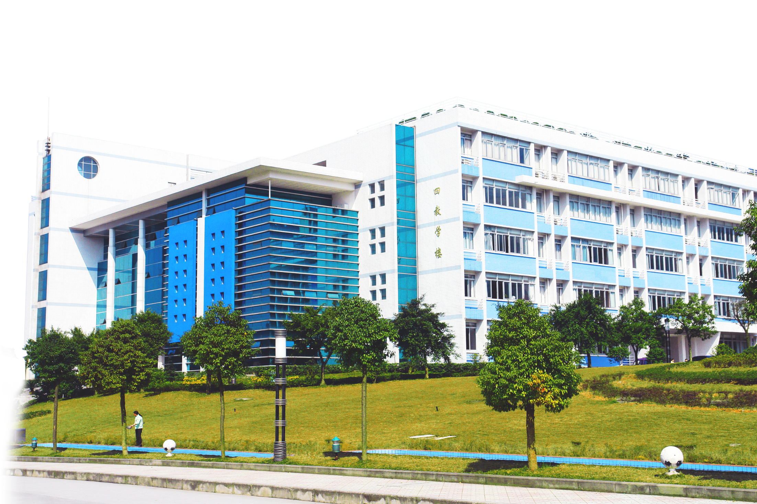
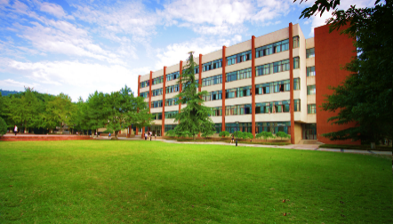
Chongqing University of Post and Telecommunications (CQUPT), founded in 1950, is a key university that has been blue-printed and heavily supported by the State. It has grown into a prominent university and is acknowledged by its excellence in the field of information industry both within and outside China.
Chongqing University of Post and Telecommunications (CQUPT), founded in 1950, is a key university that has been blue-printed and heavily supported by the State.
It has grown into a prominent university and is acknowledged by its excellence in the field of information industry both within and outside China.
CUPT AT A GLANCE

Slide 4
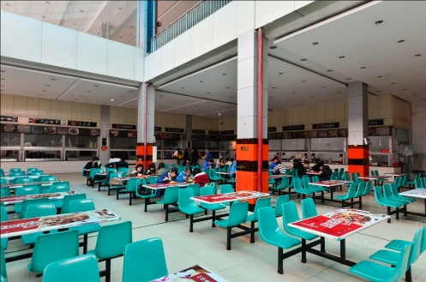
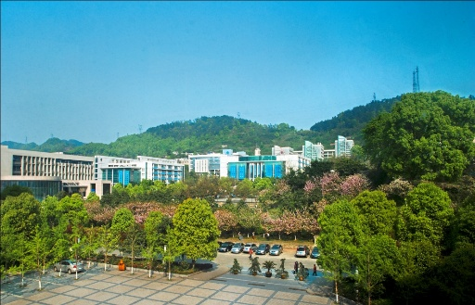
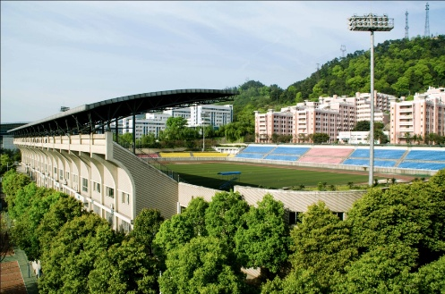
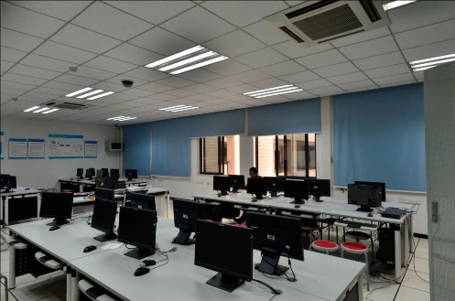
CUPT AT A GLANCE
Facts & Figures
1 campus locates in scenic resort and covers area of 680 acres;
24,000 full-time students, including 3,000 postgraduates;
More than 2,000 faculty members, including 160 professors, 400 associate professors,30visiting or part-time professors from overseas;
14 schools,47 undergraduate programs, 38 master programs, 2PhD programs;
21 key laboratories, over 600 ongoing scientific research projects at national level, and ¥660 million RMB budget for research in recent 3 years;

Slide 5
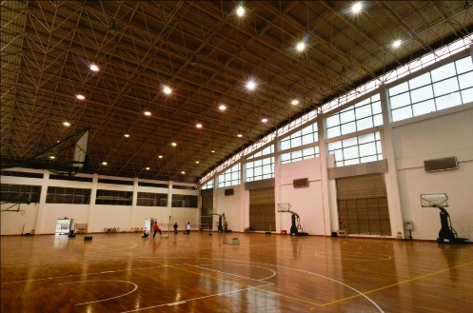
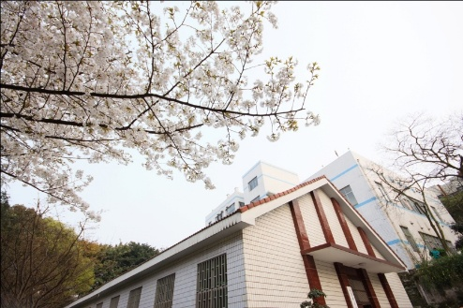
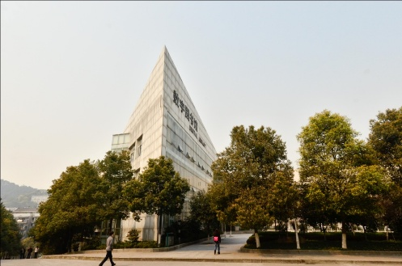
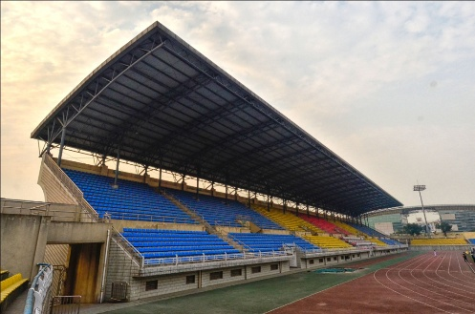
CUPT AT A GLANCE
Facts & Figures
Strong collaboration with industry in information technology and mobile communication;
Incubator for mobile communication technology;
Over 50 international partner institutions allow students to study dual degree programs, joint degree programs, or participate in short-term exchange programs;
400 foreign students from over 52 countries have been enrolled and studied degree
Programs, Chinese language programs, or cultural exchange programs.

Slide 6
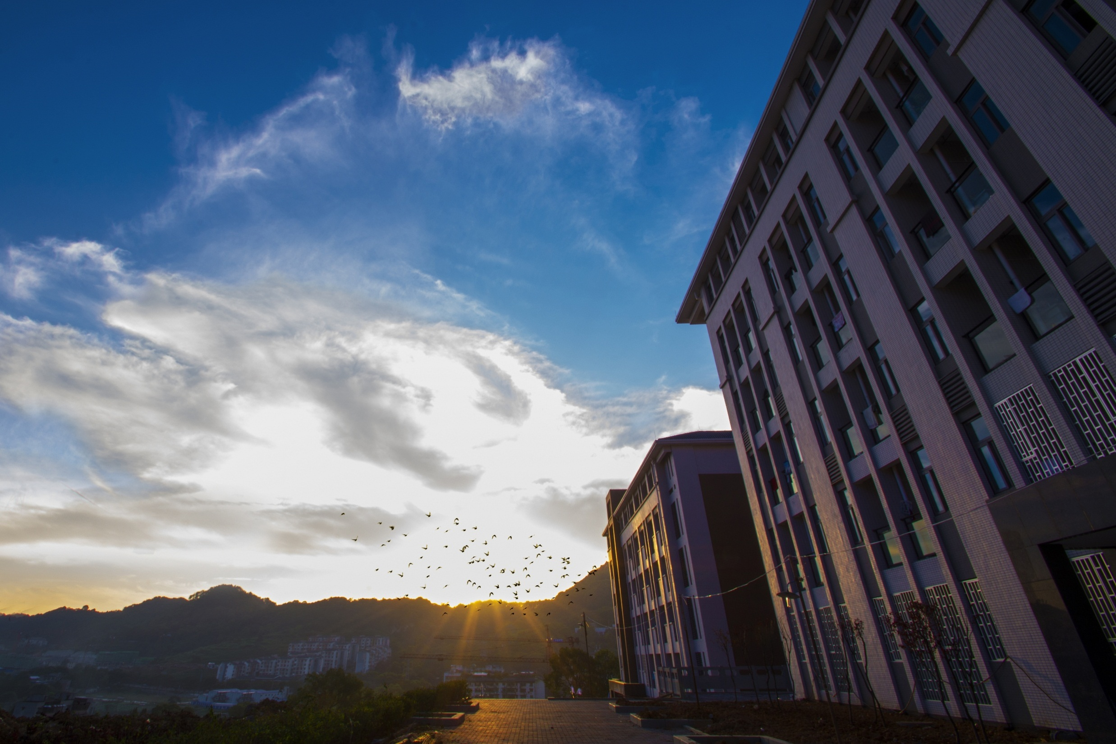
WHAT TO LEARN
IN CQUPT
Chinese Language Program
Chinese Cultural Experience Program
Degree-granting program

Slide 7
01
Chinese Language Program
( six month or one year )
CQUPT has teaching faculty with profound knowledge and rich experiences in the training programs of the Chinese Language;
20 course hours per week
The number of students in each class is under 25 so as to ensure enough opportunities for speaking and listening
In additional to the language course, other Chinese cultural course such as Chinese literature, Chinese history are also offered;
According to the Chinese proficiency, the students will be divided into different level classes.
PROGRAMS FOR INTERNATIONAL STUDENTS

Slide 8
02
Chinese Cultural Experience Program
( four weeks )
CQUPT offer a four-week study & tour program for all students from our partner institutions in every summer.
In the program, you could be:
1) Experience China’s university life
This is an exciting opportunity to be part of one of one of universities in China and earn credits towards a degree at your home university in only two weeks.
2) Immersion with Chinese students
CQUPT has over 24000 students, all short term program participants will have Chinese buddies who help them to learn about Chinese culture and practice Chinese.
3) Wide variety of Unique courses and Unique culture experience
Students will have the opportunity to take variety of unique courses to learn Chinese and its culture, and we all arrange many filed trips to let students experience the traditional Chinese culture.
4) Vibrant City
Students will have lots of time to experience Chongqing metropolitan city, which is one of the most dynamic and beautiful cities in China.
PROGRAMS FOR INTERNATIONAL STUDENTS

Slide 9
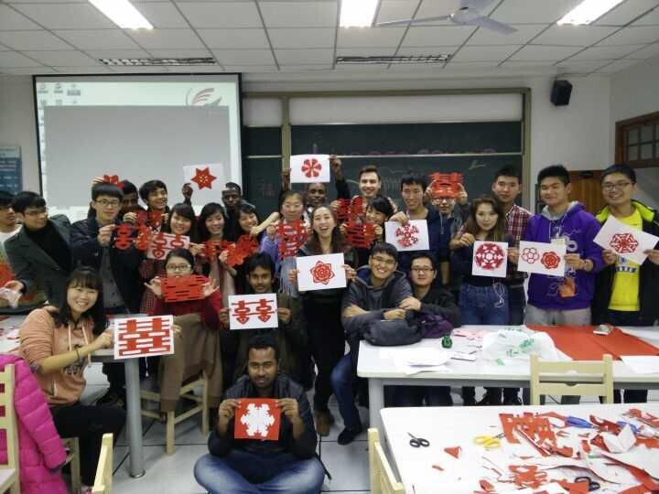
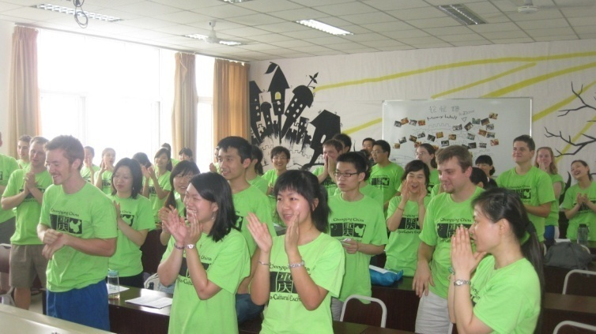
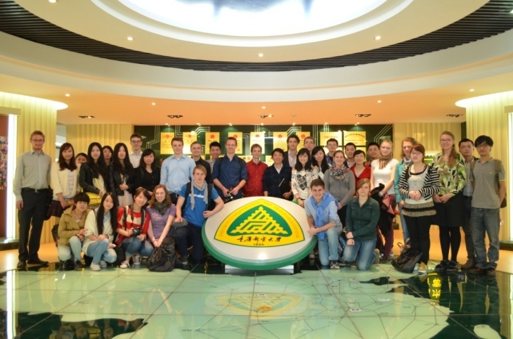
02
Chinese Cultural Experience Program
( four weeks )
Program time in 2015: 6th July to 31 July, 2015 (Four weeks)
The Fee of the program: 4000RMB
Tuition fee, accommodation fee, insurance fee, social programs and field trips fee are all include, except the meals.
The application deadline is : May 15th, 2015
PROGRAMS FOR INTERNATIONAL STUDENTS

Slide 10
03
Degree programs
School of Communication and Information Engineering
BACHELOR PROGRAM | MASTER PROGRAMS | PHD PROGRAMS
Communication Engineering | Electronics and Communication | Information and Communication Engineering
Electronic and Information Engineering | Communication and Information Engineering
Electronic Information Science and Technology | Devices and Technology
Information Engineering
Radio and Television Engineering
PROGRAMS FOR INTERNATIONAL STUDENTS

Slide 11
03
Degree programs
School of Computer Science and Technology
School of Communication and Information Engineering
BACHELOR PROGRAM | MASTER PROGRAMS | PHD PROGRAMS
Computer Science and Technology | Computer Science and Technology | Computer Science and Technology
Geographic Information System | Computer Technology
Information security | Devices and Technology
Network Engineering
Intelligence Science and Technology
PROGRAMS FOR INTERNATIONAL STUDENTS

Slide 12
03
Degree programs
School of Automation
School of Computer Science and Technology
BACHELOR PROGRAM | MASTER PROGRAMS
Automation | Controlling Engineering
Measurement and Control Technology and Equipment | Devices and technology
Mechanical Design and Manufacturing | Controlling Science and Engineering
Electrical Engineering and Automation | Industrial Engineering
Smart Grid Engineering | Mechanical and Electronic Engineering
PROGRAMS FOR INTERNATIONAL STUDENTS

Slide 13
03
Degree programs
School of Economics and Management
School of Automation
BACHELOR PROGRAM | MASTER PROGRAMS
E-Commerce | Management Science and Engineering
Information Management and Information System | Project Management
Business Administration | Logistics Engineering
Accounting
Marketing
Economics
Project Engineering
PROGRAMS FOR INTERNATIONAL STUDENTS

Slide 14
03
Degree programs
School of Optoelectronic Engineering/International School of Semiconductor(Chongqing)
School of Economics and Management
BACHELOR PROGRAM | MASTER PROGRAMS
Electronic Science and Technology | Electrical Science and Technology
Electromagnetic and Radio Technology | Integrated Circuit Engineering
Optoelectronic Information Science and Engineering | Optical Engineering
Microelectronic Science and Engineering | Electrical Theory and New Technology
Electrical Information Science and Technology
PROGRAMS FOR INTERNATIONAL STUDENTS

Slide 15
03
Degree programs
School of Bio-Information
School of Optoelectronic Engineering/International School of Semiconductor(Chongqing)
BACHELOR PROGRAM | MASTER PROGRAMS
Biotechnology | Biomedical Engineering
Biomedical Engineering
Bioinformatics
Pharmaceutical Engineering
Electrical Information Science and Technology
PROGRAMS FOR INTERNATIONAL STUDENTS

Slide 16
03
Degree programs
School of Media and Arts
School of Bio-Information
BACHELOR PROGRAM
Broadcasting, TV Program Editing and Directing
Art Design
Animation
Digital Media and Arts
PROGRAMS FOR INTERNATIONAL STUDENTS

Slide 17
03
Degree programs
Law School/School of Ideological and Political Education
BACHELOR PROGRAM | MASTER PROGRAMS
Law | Political Science
Intellectual Property | Procedural Law
PROGRAMS FOR INTERNATIONAL STUDENTS

Slide 18
03
Degree programs
School of Software Engineering
BACHELOR PROGRAM | MASTER PROGRAMS
Software Engineering | Software Engineering
PROGRAMS FOR INTERNATIONAL STUDENTS

Slide 19
03
Degree programs
School of Mathematics and Physics
BACHELOR PROGRAM | MASTER PROGRAMS
Mathematics and Applied Mathematics | Physics
Information and Computer Science | System Science
Applied Physics
PROGRAMS FOR INTERNATIONAL STUDENTS

Slide 20
03
Degree programs
School of Foreign Language/International School
BACHELOR PROGRAM
English
OTHER PROGRAM
Chinese
PROGRAMS FOR INTERNATIONAL STUDENTS

Slide 21
03
Degree programs
School of Physical Education
BACHELOR PROGRAM
Physical Education for Community
PROGRAMS FOR INTERNATIONAL STUDENTS

Slide 22
Application
Admission Qualification
Programs | Qualification | Duration
Chinese language courses | No special requirements | 3 months/half a year /1 year
Undergraduate | With senior high school diploma and HSK certificate of level 4 or above | 4 years
Graduate | With Bachelor’s degree and HSK certificate of level 4 or above | 3 years
PhD | With Master’s degree and HSK certificate of Level 5 | 3-5years
If applicants would like to apply for the degree programs taught by Chinese, but their Chinese language could not meet the entrance requirement, they need to study the Chinese Language first in our university until they pass the HSK certificate level 4 or level 5.
How to Apply

Slide 23
Scholarship
There are 3 types of scholarship which international students can apply for:
1.Chinese Government scholarship
2. The Chongqing Municipal Government scholarship
Programs | Scholarship (RMB￥/one year)
 | First class | Second class
PhD | 35,000 | 20,000
Graduate | 30,000 | 15,000
Undergraduate | 25,000 | 10,000
3. President Scholarship of CQUPT as follows:
Programs | Scholarship (RMB￥/one year)
 | First class | Second class
PhD | 12,000 | 10,000
Graduate | 10,000 | 8,000
Undergraduate/Chinese language course | 6,000 | 4,000
Scholarship

Slide 24
A web-based digitalized networking covering the campus, resource and activities;
Two school libraries boast storage of over 3 million books in both paper and electronic occupies;
39on-campus student dormitories with over 6,800 rooms are available to accommodate students;
5 student dining halls catering needs of dinners;
The sports stadium, field and gym/fitness center satisfy the needs of sports events, fitness training or service;
School hospital, post office, grocery stores/convenient shops are all available for access of medical, shopping, posting or other supporting services.
CQUPT is well facilitated for research, study, extracurricular and living. The Student Union and 84 student associations with over 8,000 student members have been established for the purpose of enriching and boasting the dynamic campus life. CQUPT students are encouraged to participate in variety of science fairs/competitions, academic contests, job fairs, sports/games competitions, arts/works exhibitions and social or community volunteer work.
CAMPUS LIFE

Slide 25
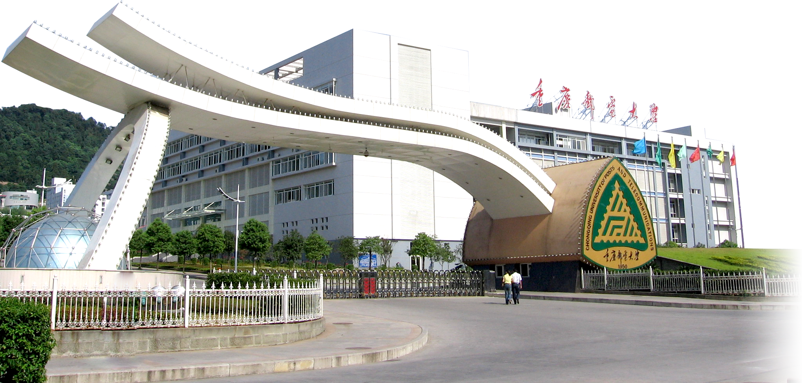
+86-23-62487785
wjwy2008@hotmail.com
Telephone Number
Email
Mrs Wen Jin (Joyce)
+86-23-62487912
No.2 Chongwen Road,
Nan’an District, Chongqing 400065
Fax Number
THANK YOU

